Slide 1
Jio Telecom-Newer Business Model 27/9/2022
REVA Academy for Corporate Excellence (RACE)
ANAND MOHAN
MBA Participant
www.reva.edu.in

Slide 2

JIO Telecom Management Team
Rainer Deutschmann-chief product innovation officer
Tareq Amin-senior vice-president-technology
Nikola Sucevic-lead, data analytics development
Stratos Davlos-head, platform and engineering;
Janina Anjuli Schmidt-design lead
Caroline Seifert-former chief brand and design officer.

Slide 3
Business proposal
Jio Platforms is an Indian technology company and a subsidiary of Reliance Industries, headquartered in Mumbai, India. Established in 2019, it acts as a holding company for India's largest mobile network operator Jio and other digital businesses of Reliance.
who is our client?
Demand for Traditional Connectivity Services Is Decreasing in Telecom sector. Therefore AI and Cyber security solution as a newer initiative is being proposed.
It need to cater to Security and the Risk of Data Breaches.
It should incorporate Artificial intelligence based voice commands instead of text to interact with machines.
It should Gear Up for More Newer Technology including Text Analytics, Sentiment Analysis and Topic Modeling.
What is required?

Slide 4
Problem Statement
Current Technology
Current Technology in JIO Smartphones not adequate to newer challenges
Need to cater to Cybersecurity threats namely Phishing detection, Network security, secure authentication and prevention of online frauds.
Cyber Security
Chat automation i.e. need to automate the process of responding to customer queries with natural language processing. Voice and speech recognition technology to provide digital assistance. Analyze and gain insights on customer behaviors using predictive and prescriptive analytics.
AI solutions

Slide 5
AI and Cyber Security
Breach attempts
61% of Business enterprises say they cannot detect breach attempts today without the use of AI technologies.
Breach attempts are proliferating with Cisco reporting that in 2018, they blocked seven trillion threats on behalf of their customers.
Budgets for AI in Cyber security
48% say their budgets for AI in cyber security will increase by an average of 29% in Fiscal Year (FY) 2020.

Slide 6

Objective
Easily configurable with minimal customization.
use the latest AI/ML technologies to provide meaningful insights for key business decision making.
Empowering mobile apps by making them intelligent pieces of software that can predict user behavior and make decisions.
protecting private data via cyber security.
prevent user from clicking malicious links camouflaged as genuine once.

Slide 7
Solution Proposed
Jio chat-Text Analytics, Sentiment Analysis, Topic Modeling
Jio cloud
Voice Automation- Alexa
Jio Telecom
JIO Security

Slide 8
Technology Description
Implementation of AI Module-
Implementation of Cyber Security Module
Research and Data Analysis Module, Sentiment Analysis, Topic Detection, Word clouds, Chatbots
product security, infrastructure security, people security.
Machine Learning-Azure Studio
Integration-Azure Logics
Data Visualization-Power BI apps
Hosted on Azure Cloud
Network security monitoring-Splunk
Encryption-TrueCrypt
Web vulnerability scanning- SQLMap
Penetration testing-Kali Linux
Antivirus software-Norton 360
Firewall-Tufin

Slide 9
Solution Proposed through Text Analytics :
1.Improve customer experience.
2. Reduce unnecessary service calls and in-person appointments through proactive customer care.
3.Analyze the potential of new offerings.
4.Reduce customer churn rate.
5.Analyze customer feelings and viral Topics among customers with respect to Telecom perspectives using Topic Modeling and Sentiment Analysis.

Slide 10
Solution Proposed through AI:
1.Combatting Traffic Overload: it can create automatically the number of virtual machines, required to handle the incoming amount of Text traffic, and funnel the excessive traffic via these virtual machines, promptly and without human involvement.
2.Optimizing Service Quality by Predicting Future Network Usage.
3.Performing Predictive Maintenance-it can detect various alarming network signals that may indicate probable forthcoming network failure.
4.Averting Malicious Actions: With Machine Learning, network can be trained to identify a large number of Malicious requests and make a decision on whether to deny these requests flat-out, or shunt them to another.

Slide 11
Key Drivers-Machine Learning
SQL Data warehouse will be source of transactions data from Tweeter blogs and chatbots and incremental data will refresh to Data Warehouse at end of the day daily.
Chatbots and Jio cloud voice automation tool will update periodically and continuously information in SQL data warehouse and will be responsible for execution of machine learning applications and predefined scripts.
Models will retrain automatically daily on end of the day data based on tweeter blogs.
Machine learning APIs output to be exposed to SQL Data warehouse, Machine learning models integration with ML environment within the mobile device will be taken up as a backend daemon process.
Estimation is based on Azure ML studio as the ML development environment.
A total of 10 Power BI reports and 5 Dashboards are assumed to be developed every 2 weeks through automatic process using power BI apps installed on the mobile device.

Slide 12
Key Drivers-Cyber Security
Penetration testing is consistently performed randomly on mobile apps to protect mobile data and features from security loopholes.
VPN tunnel is being deployed to ensure that sensitive information transmission is protected against privacy leaks and data theft.
Mobile app data encryption using SQLite database encryption Models is being implemented.
Biometric authentication using fingerprints and retina scan is being implemented as authentication measures for accessing mobile access.
Antivirus software is being constantly updated and automatic scanning of the system is being performed by using automated scripts.

Slide 13
Transformation Blueprint
Acquisition
Servicing
Collection & Recovery
Origination & Fulfilment
Machine Learning
Customer 360 View
Market Execution
Segmentation Models
AI Module
Cyber Security Module
Campaign Response
Sentiment Analysis
Subscribe
Data Warehouse
Topic Modelling
Encryption
Affiliate Marketing
Power BI
Antivirus
Dynamic Analysis
Firewall
Intelligent Automation
Bot Framework
Voice assistants
ML Data Visualization
Market Basket Analysis
Biometric Authentication
Predictive Analytics

Slide 14
Opportunity| Market changes | JIO Positioning
Opportunity
Market Changes
JIO Positioning
Traditional Telecom services in AI and Cyber security are expensive and mostly negligible
Difficult for small business owners to address their need for AI and Cyber security enabled mobile.
Alternate arrangements to cater to AI and Cyber security need are expensive.
Rapid burgeoning interests in AI and cyber security enabled mobiles.
Capturing a loyal userbase has huge revenue potential.
First mover advantage.
scalable across multiple platforms.
provides Low cost services.
Target customer needs.

Slide 15
Solution Delivery Process
3 releases using standard waterfall (Plan, Analyze, Design, Build, Test, Deploy)methodology:
Release1:Customer 360 view(basic), Test, System training, Warranty
Release2:Implementation of AI Module-ML models, Integrations, Power BI Apps reports & Dashboards, System training, Warranty
Release 3:Implementation of Cyber Security Module, Network security Monitoring evaluation, Encryption testing, web vulnerability scanning, penetration testing, firewall testing, system training, Warranty.
Each release will have 3 weeks of system training followed by 4 weeks of warranty support.IT support and Devops team will be playing pivotal roles during project testing and deployment phase.
Solution Delivery
Deploy
Test
Build
Plan
Analyze
Design

Slide 16

Testing and Bug fixing
Functional and Integration testing will be manually executed.
Each release has functional testing. Release 2 will also have integration testing.
Release 3 will also have Integration testing, Performance and Systems testing.
Functional and Integration testing will have 2 cycles each. Performance and Systems testing will have 3 cycles each.
Each cycle execution will be followed by defect fixing effort. Defect fixing prioritization will be based on defect priorities and assumed to fix all high and medium priority defects before completing the test cycle.
Regression testing will be performed after completion of each releases with sanity testing performed every 2 weeks till the culmination of release 3 process. Jira Software will be used for bug tracking and agile project management.

Slide 17
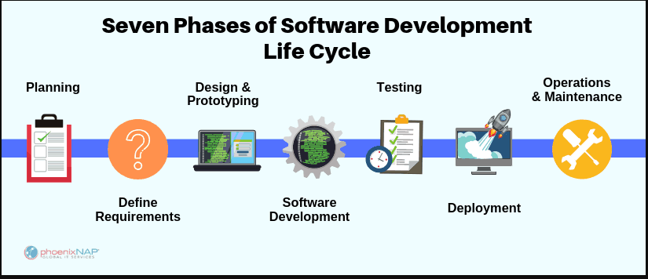
Systems development life cycle

Slide 18
Systems development life cycle
Key Phases and Activities | M1 |  | M2 | M3 | M4 | M5 | M6 | M7 | M8
Project Management
Solution Architecture
Plan, Analyze, Design and develop. Meetings to understand current capability. Business process Review Gap Analysis. Use case identification Design deliverables Development and white box Testing
Release1 Customer 360 view(Basic )Live support
Release2\
Release3
Deployment, Training Plans, Delivery

Slide 19
Risk and Cost Analysis
Risk Description | Impact Description | Mitigation
Delay in environment availability(establishing connectivity between the various components hosted on Mobile device and the components hosted in Azure cloud) | Delay in task completion could impact the schedule. | Dedicated workstream created to cater to infrastructure requirements. status and progress to be tracked during governance meetings. proactive steps to be taken to mitigate challenges and potential delays.
Cyber Security and Machine learning are niche skills. There can be staffing challenges because staffing some of the roles will be based on project start date. | schedule and cost. | Detailed plan to identify critical resources and their onboarding. working closely with resource sourcing team to onboard the identified critical resources.
Risks due to product feature release. | schedule and cost. | product feature release needs to be accessed from time to time and appropriate changes be made to the project timelines.

Slide 20
Revenue Generation due to AI module in JIO:
Jio can charge subscription fee from the customers who uses services provided by their newly developed AI and ML framework in Jio phones.
Jio can earn revenues from affiliate marketing. It can earn a commission fee every time someone follows an affiliate linked placed on their AI and ML apps in jio phones.
Third party vendors can subscribes to Jio's AI and ML apps and these vendors may provide services to their own customers based on JIO's AI and ML apps. Jio may charge service fee from both vendors and customers of their vendors who uses JIO's AI and ML framework.
JIO can use their own AI and ML framework to enhance Mobile commerce of their vendors and thereby increasing revenues for themself as well. JIO can do market based Analysis for their vendors using their own AI and ML framework and generate revenues from them.
JIO can provided services of AI AND ML based voice assistants to deliver value to their vendors and thereby increasing its own revenue collections.
JIO can utilize market based analysis to provide better enhanced analysis of their own core customers for their mobile thereby increasing revenues from their own core businesses as well.

Slide 21
Revenue Generation due to Cyber security in JIO:
It builds trust and inspires customers confidence thereby increased revenues from their own businesses.
It drives competitive advantage from other companies who are in telecom businesses.
Added values due to cyber security enhancements also strengthens pricing options for JIO telecom.
Cyber security features add brand values and reputation of JIO mobiles leading to expanding of their avenues and their business partners.
It can develop their own anti viruses, encryption based services and Biometric authentication capabilities and sell them to their own clients leading to increase in their annual revenues.

Slide 22
Existing Challenges for AI in Telecom:
Lack of Resources: Network engineers in the telecom industry do not have the background to include the mathematical training and experience that is essential in ML and AI.
Lack of Tools: One of the significant challenges in AI implementation is the lack of tools in the telecom sector.
Network management :Managing the complexity of AI enabled huge network is overwhelming for network technicians and require training and experience in dealing with it.
The Telecom providers will still rely heavily on human expertise, especially in early stages.
The network operations team will use AI to identify potential root cause issues, but those team members won't have the AI close the loop and automate the fix.
Only when the AI solution has developed a track record and the operations team has a high degree of confidence in its recommendations and ability to prescribe and act appropriately should an AI solution be used to fully automate processes.

Slide 23
Competition Analysis:
Vodafone’s SuperIoT Uses AI to Optimize Networks. In 2018, Vodafone launched its AI chatbot, Tobi, a virtual service agent powered by IBM Watson, which helps customers seeking answers to basic questions over web chat. Tobi is currently exploring integration with Amazon’s personal assistant Alexa with advanced machine learning features.
In September 2017, Bharti Airtel partnered with SK Telecom, Korea’s largest telecom company latter to use its specialized network operating system. It is an AI-assisted network operating system with big data analytics and machine learning capabilities.
63.5% of operators are estimated to be investing in AI systems to improve their infrastructure.
Aria Networks: It uses AI-based network optimization solution.
Nokia launched its machine learning-based AVA platform to better manage capacity planning, and to predict service degradations on cell sites up to seven days in advance.

Slide 24
Competition Analysis:
Concern
Response
Large companies will leverage ability to provide at lower prices.
Jio has a very loyal and unique target audience and has the first mover advantage.
Consumer concerns over security on a newly introduced platform.
Third party vendors verifies service and secure server makes security claims unfounded.
Jio will face execution risks.
JIO has successfully run and experienced management team.
No defining industry standard
flexibility of the industry promotes innovation. A standard will soon be reached.

Slide 25
Competition Advantage of Jio Telecom:
Strongest Customer Acquisition strategy
Strong backing by parent company
Innovative technology
Strong customer base
Sizeable Market share
Brand management and advertising strategies
Fast and wide network
Multiple offerings under a single name
LYF Smartphones

Slide 26
Competition Advantage of Jio Telecom:
Competition Advantage JIO
Huge Market Opportunity
Inspiring and Experienced Management Team
Defensible Business and Strong Execution Strategy
High Future Valuation and ROI even with Later Stage Investments
Solid Business Model with High Revenue Generation

Slide 27
Opportunities of Jio Telecom:
Competitive Pricing Strategies
Expansion to other countries
Focus on customer service and Mobile Number Portability
Partnerships and collaborations
Focus on 3G customers also
Future Opportunities in related segments-Text Analytics, Media, Medical Domain, E-marketing.
Focus on Newer Technologies like AI, Cyber security need to be explored.

Slide 28
Opportunities of Jio Telecom:
Target Customer
Small businesses, independent workers, individuals selling goods.
Market anyone who uses their JIO mobiles and are probable future prospects.
JIO's cost: gaining customer awareness, free dashboard enabled Apps in AI, software services providing Cyber security in jio mobiles
Selling Points
Advertisements
Retail
selling through online registration and showrooms.
follows razor blade retail model.
social media and internet advertising.
Traditional mediums with max exposure and minimum cost.
Easy convenient everyday usage.
no surprise fees.
Adaptable across multiple devices.
Acquiring 150,000 +customers per quarter

Slide 29
Opportunities of Jio Telecom:
Competitors
Characteristics
Jio advantage
Direct Competitors:
Vodafone, Bharti Airtel, Idea
Emerging Market:
AI and Cyber security
Similar technology options.
Higher fees and rates for certain options.
Built in hardware and proprietary software's for phones.
cross interaction with other mobile apps.
Established clientele as first mover.
No credit check.
No monthly fees.
Device compatibility.
compatible across differing hardware.
unique market focus.

Slide 30
Cost and Growth analysis of Jio Telecom:
Need for additional Investments
High potential
for growth
Additional resources needed to maintain first mover advantage.
competitive pressures increasing.
expected spend in advertising and customer acquisition.
potential for growth will allow new investors to see an outsized return.
customer adoption will scale up exponentially.
The key to success will be in locking in a loyal customer base early.

Slide 31
Customer Acquisition plans of Jio Telecom
Target Audience of Jio Telecom:
Jio’s target of having 100 million subscribers in 100 days after its launch speaks volumes of their
marketing strategy. Currently, the company’s revenue is around 1.6 billion dollars approximately.
Jio paid interest in providing the best and cheapest Internet data services, so their target audience became the one’s having Smartphone, looking for high-speed internet connection.
Not only is Jio targeting people using smartphones but also the industries which require the use of digital technology. Bridging gap between customer merchants and the final consumer.
Jio’s plan is uniquely devised to capture any industry which requires the use of technology including AI,IOT and voice automation. Some specific industries include Education, Healthcare, Media and payment channels.

Slide 32
Customer Acquisition plans of Jio Telecom
Selling point:
free services to it’s customers in the beginning, bundled with a variety of services which allowed for On-demand streaming of movies, TV and music.
Easy Activation –Easy processing with e-KYC, home delivery and quick activation.
Customer Retention – offered Prime Membership for extremely competitive price.
Referral Marketing – Jio did not invest big money in advertising. It relied on word of mouth and referral marketing.
Superior Technology – Jio had VoLTE, with a capability of handling voice calls with the help of data and hence created an edge over competitors.

Slide 33
Customer Acquisition plans of Jio Telecom
Advertisement:
Jio has been very aggressive with its promotional campaign, both online & offline.
In December 2016, Jio collaborated with Pokemon Go. The popularity of Pokemon Go helped to promote Jio within the younger section of the society.
Jio was spread on all social media platforms like Instagram, Facebook, Twitter, and YouTube.
They signed popular celebrities as their brand ambassador.
They have launched ad campaigns on television, radio, newspapers, magazines, and billboards. They made sure to have a sort of omnipresence in people’s minds.
Another genius move by Jio was the free internet Wi-Fi services they offered at six cricket stadiums during free internet Wi-Fi services at six cricket stadiums.

Slide 34
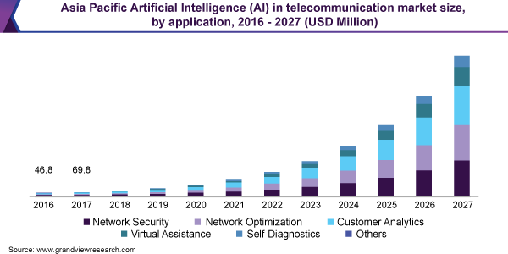
Market Validation-AI in Telecom
The global artificial intelligence in telecommunication market size was valued at USD 679.0 million in 2019 and is expected to grow at a compound annual growth rate (CAGR) of 38.4% from 2020 to 2027.

Slide 35
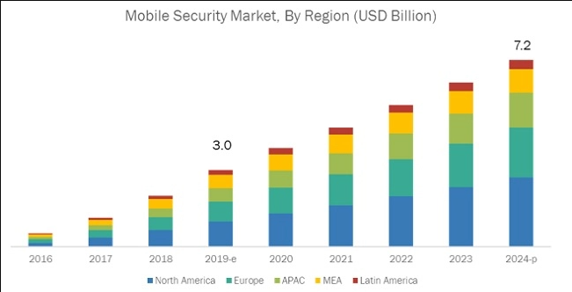
Market Validation-Cybersecurity in Telecom
The global mobile security market size is expected to grow from USD 3.0 billion in 2019 to USD 7.2 billion by 2024, at a Compound Annual Growth Rate (CAGR) of 19.4% during the forecast period. As a result, adoption of the mobile unified endpoint security products that include firewall tools, antivirus and malware protection solutions, organization size security solutions, and mobile device management solutions has increased among businesses.

Slide 36


